Slide 1
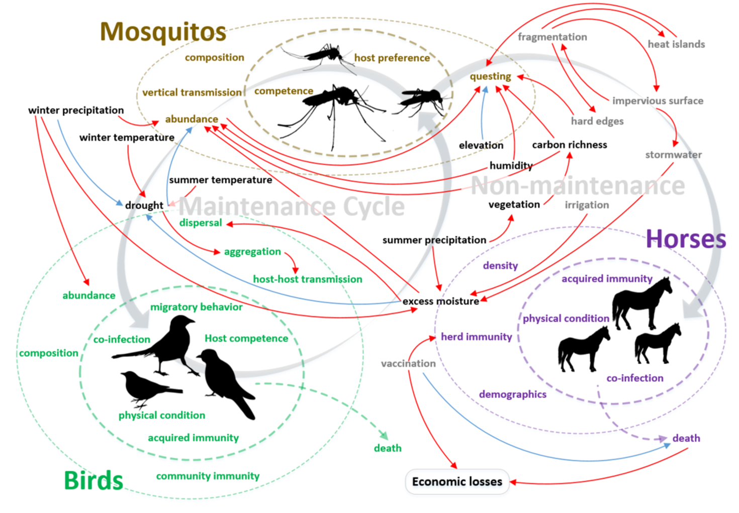
The GeoEpi Research Group
The GeoEpi Group investigates animal disease transmission and outbreak dynamics. Leveraging statistical and mathematical modeling, bioinformatics, and artificial intelligence, our work aims to bridge the molecular and landscape scales to reveal insights into the ecology and spatiotemporal dynamics of foreign, transboundary, emerging, and zoonotic animal diseases.

Slide 2
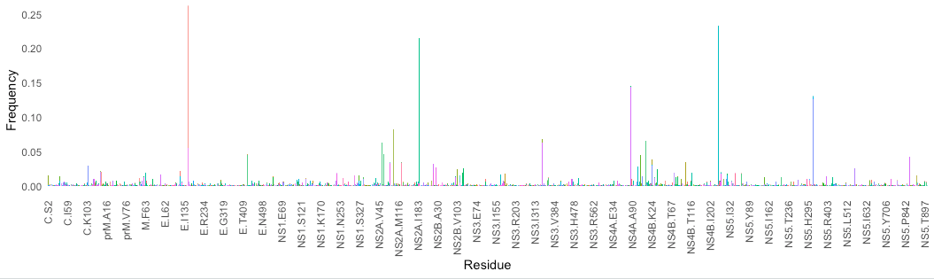
E-V159A (94%)
WN02
NS4B-I240M (23%)
NS2A-R188K (21%)
NY10
NY10
NS4A-A85T (14%)
NS5-K314R (13%)
SW03
SW03
C
M
E
NS1
NS2A
NS2B
NS3
NS4A
NS4B
NS5
Structural
Non-structural
Frequency of all known non-synonymous mutations in WNV polyprotein, 1999-2020

Slide 3
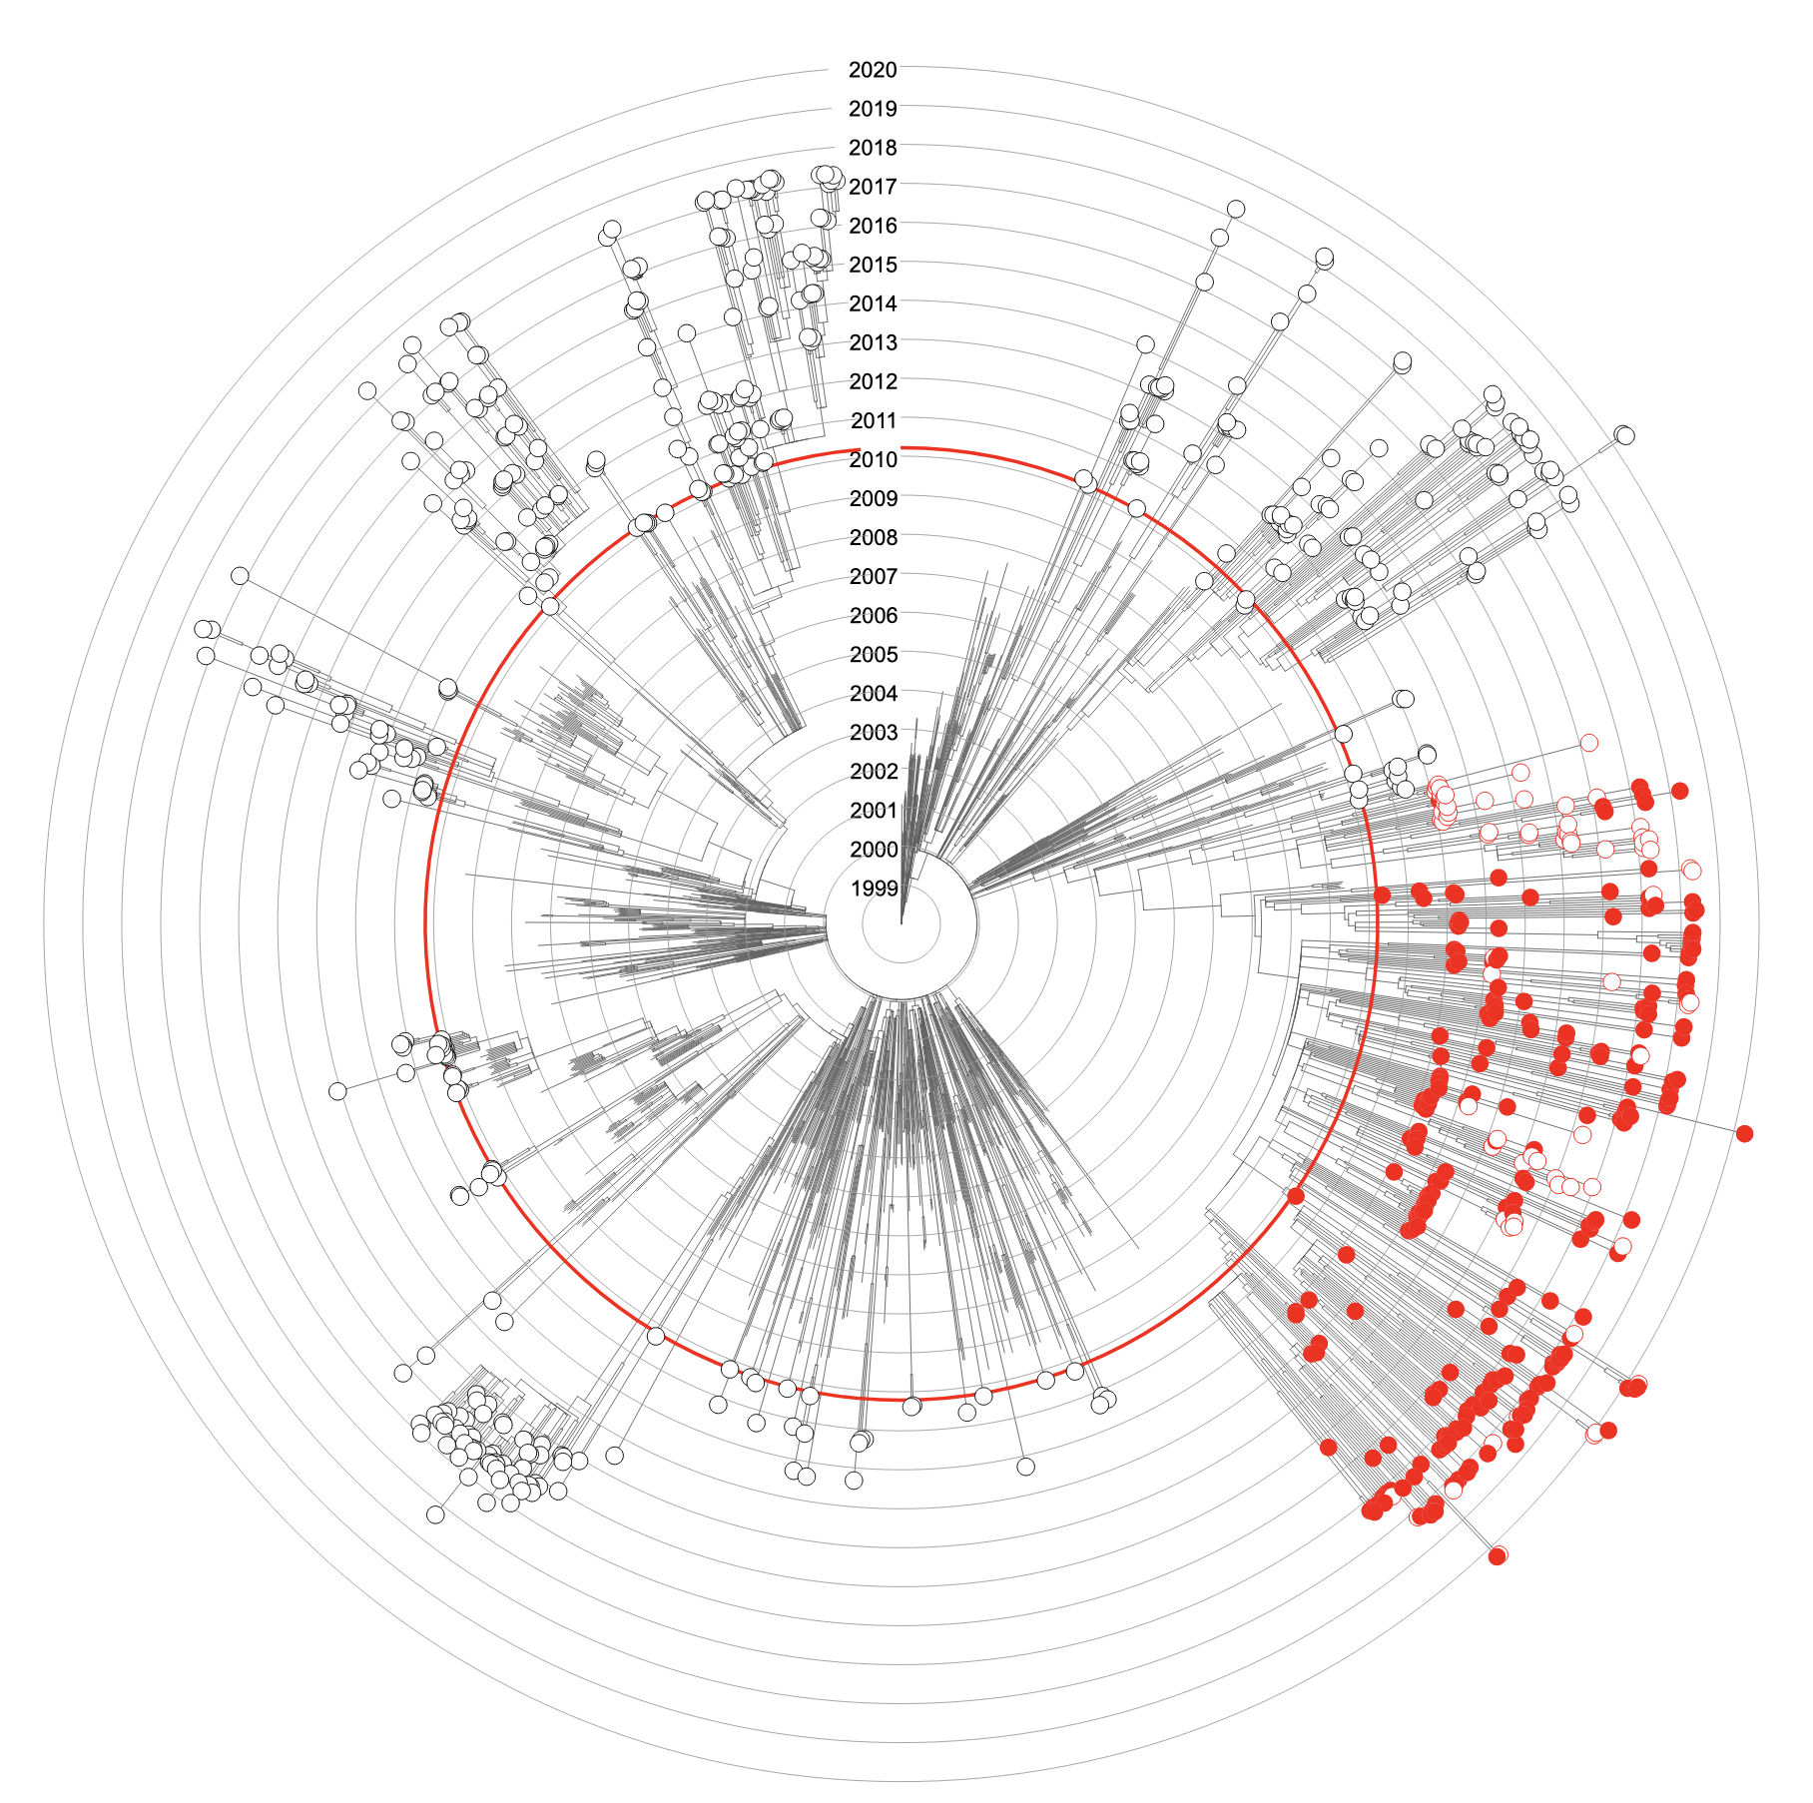
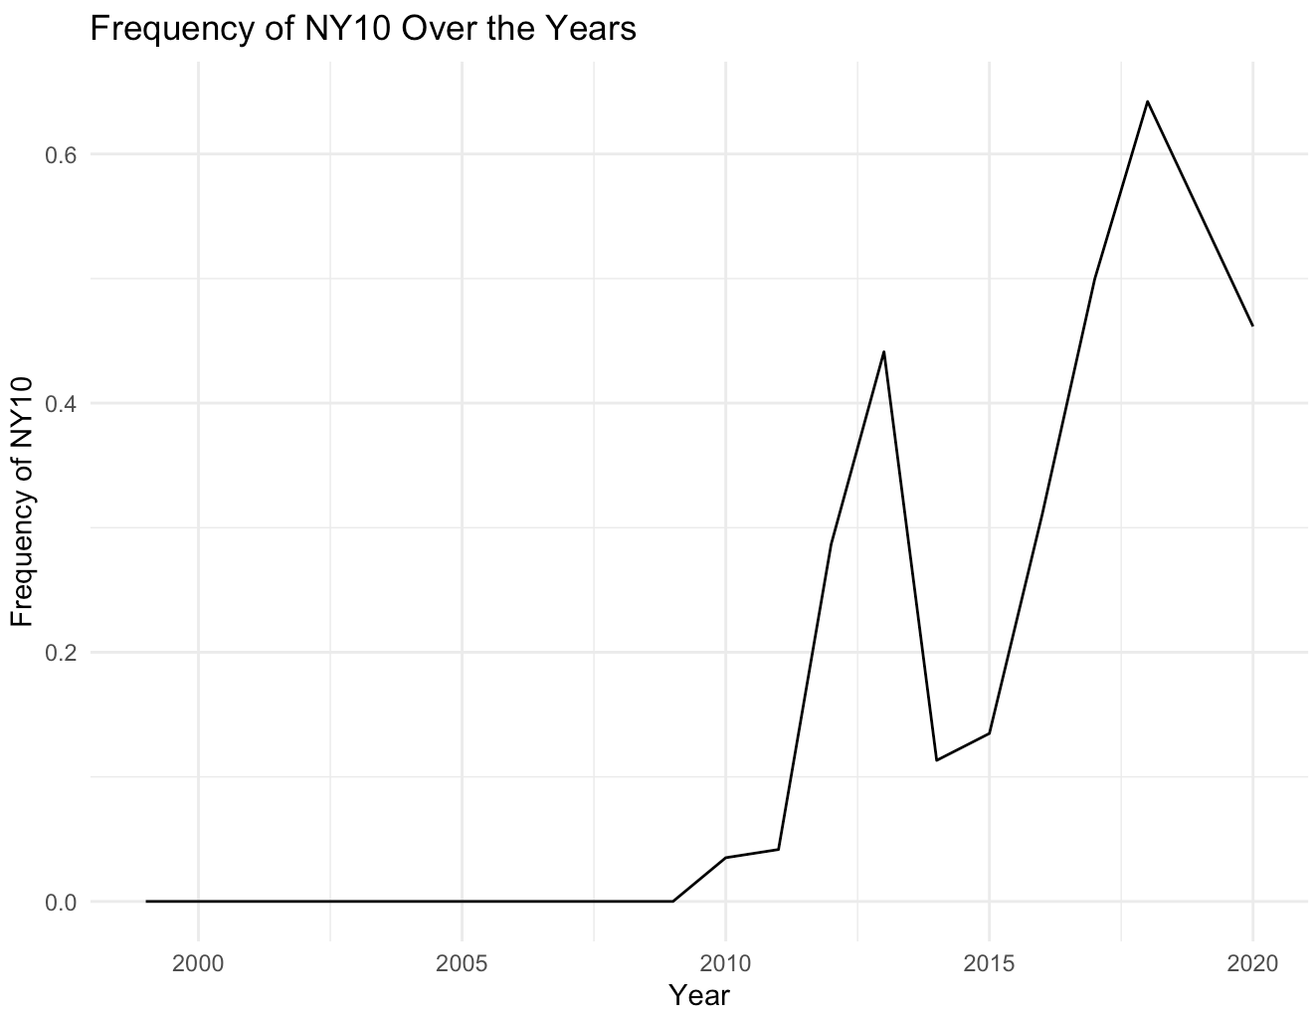
NY10 (NS2A-R188K & NS4B-I240M)
Loss of key mutation
Other lineages
First appearance of NY10
NY10 represents largest WNV lineage currently circulating in U.S.

Slide 4
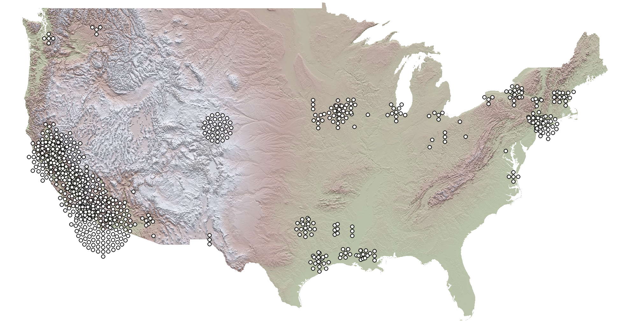
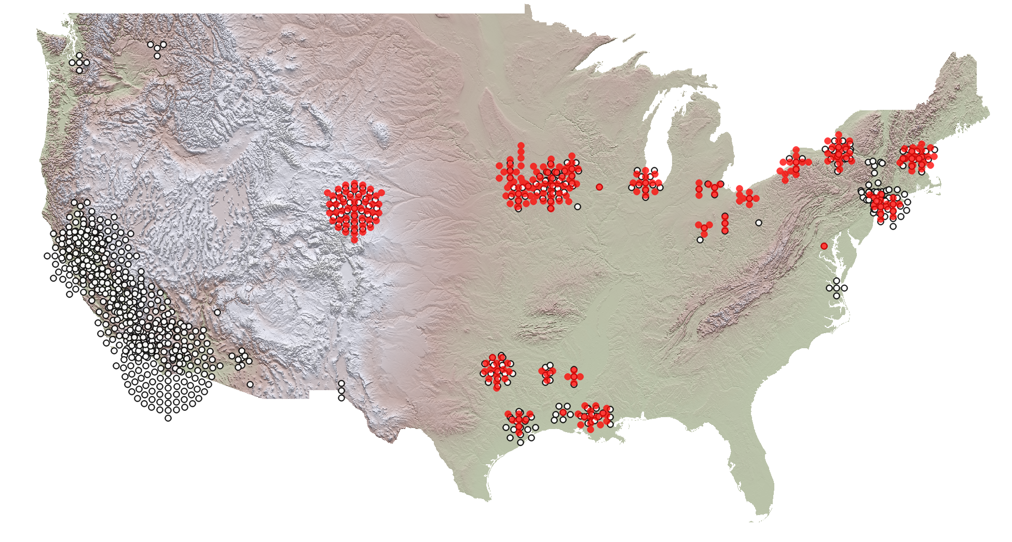
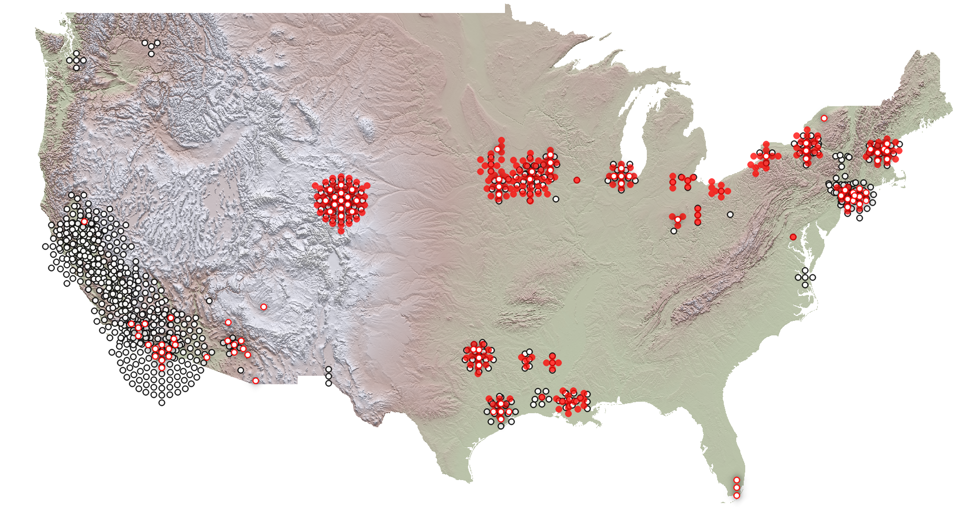
NY10
Loss of key mutation
Other lineages
Apparent geographic isolation of the NY10 lineage

Slide 5
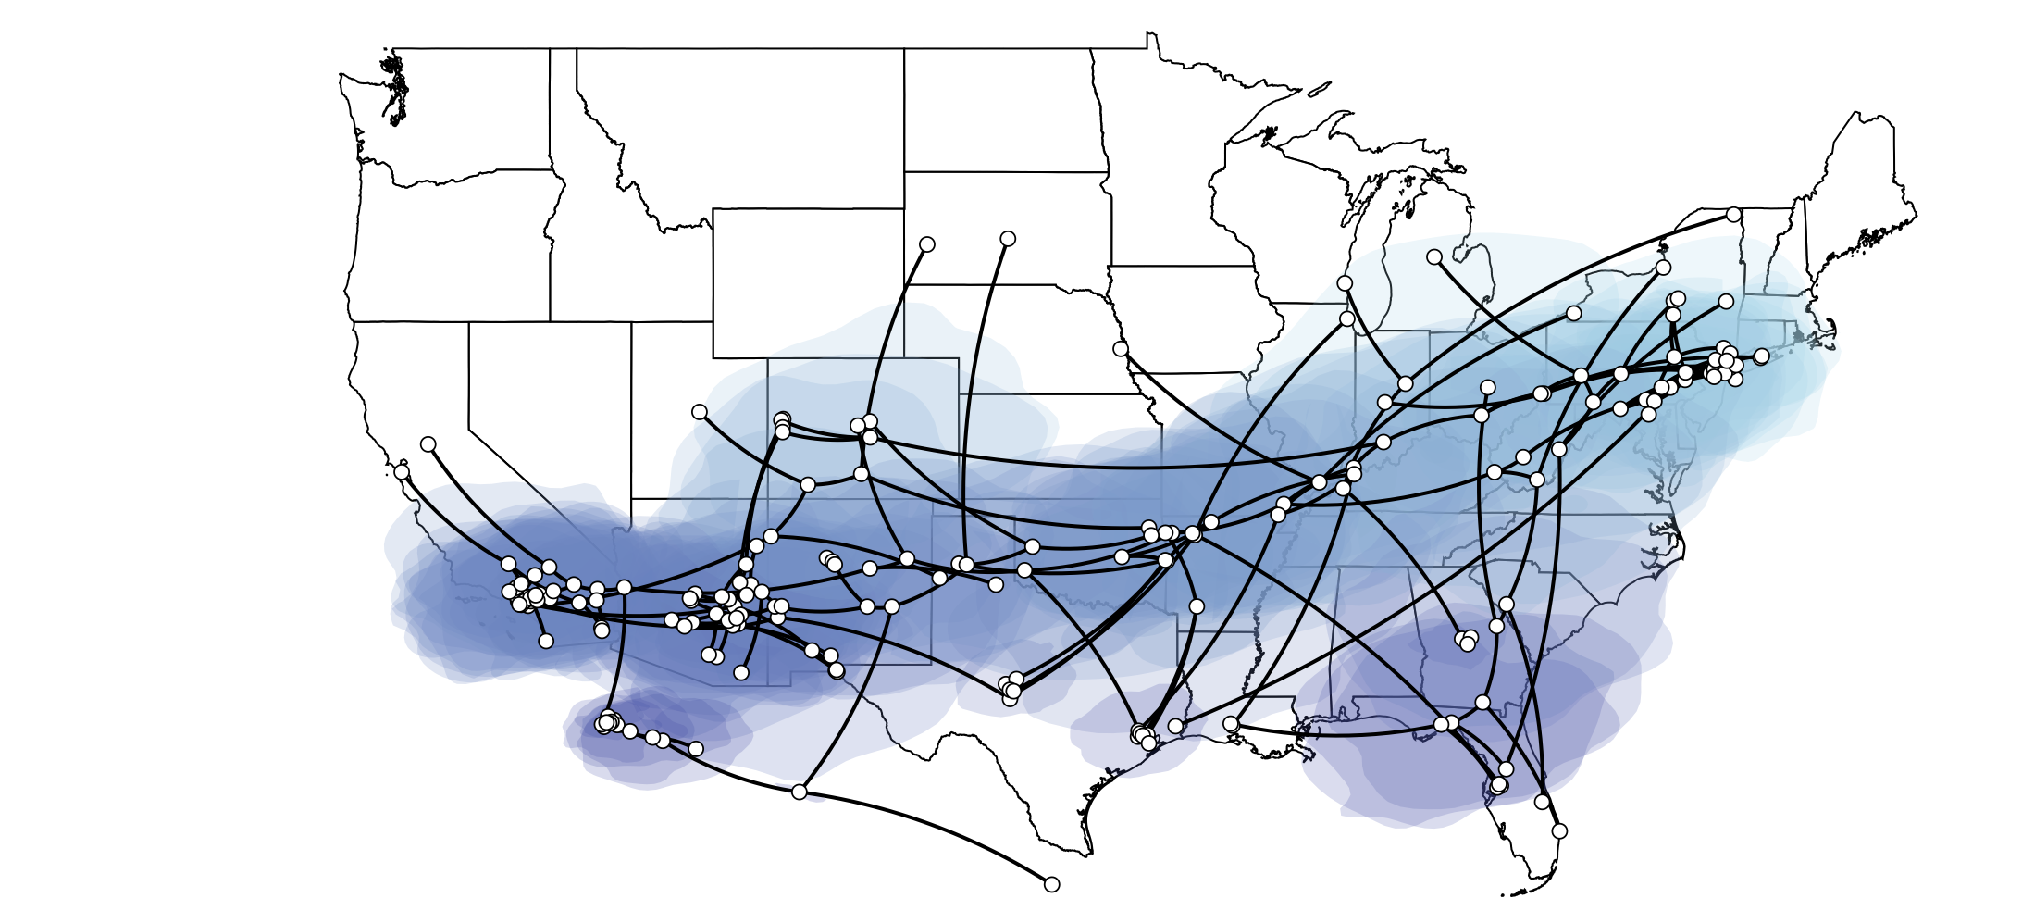
Approach:
Questions:
Why has NY10 been so successful?
Why does that success appear to end at the Rockies?
Phylogeographic reconstruction
+
Bird distribution models
Hypotheses:
Adaptation to specific host or vector species,
Leading to filtering at the boundaries of species ranges
General fitness increase to virus with costs
linked to climate sensitivity
+
Mosquito distribution models
+
Climate models

Slide 6
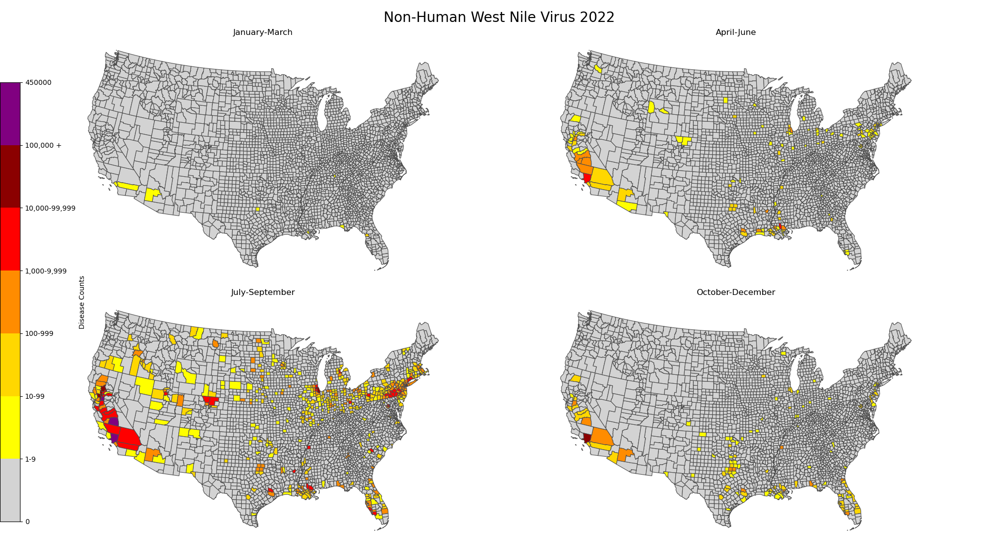
Forecasting West Nile Virus Transmission Using AI Models: Unraveling Spatiotemporal Patterns for Targeted Intervention and Early Warning Systems
Notes:
-Displayed here
-Identify patterns for intervention and early warning
-safeguard human health and integrity of livestock

Slide 7
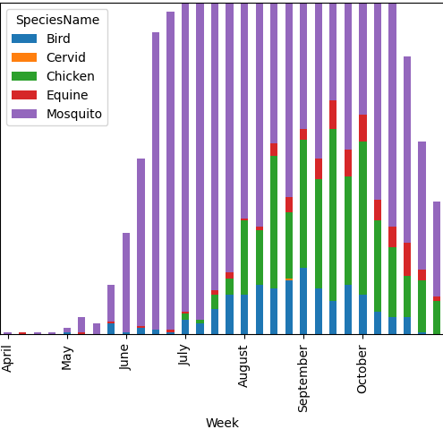
Seasonal Species
Epidemic Trend
Notes:
-Observe trajectory of wnv
-discern patterns in disease among hosts
-aids in formulation of targeted mitigation and curb disease spread

Slide 8
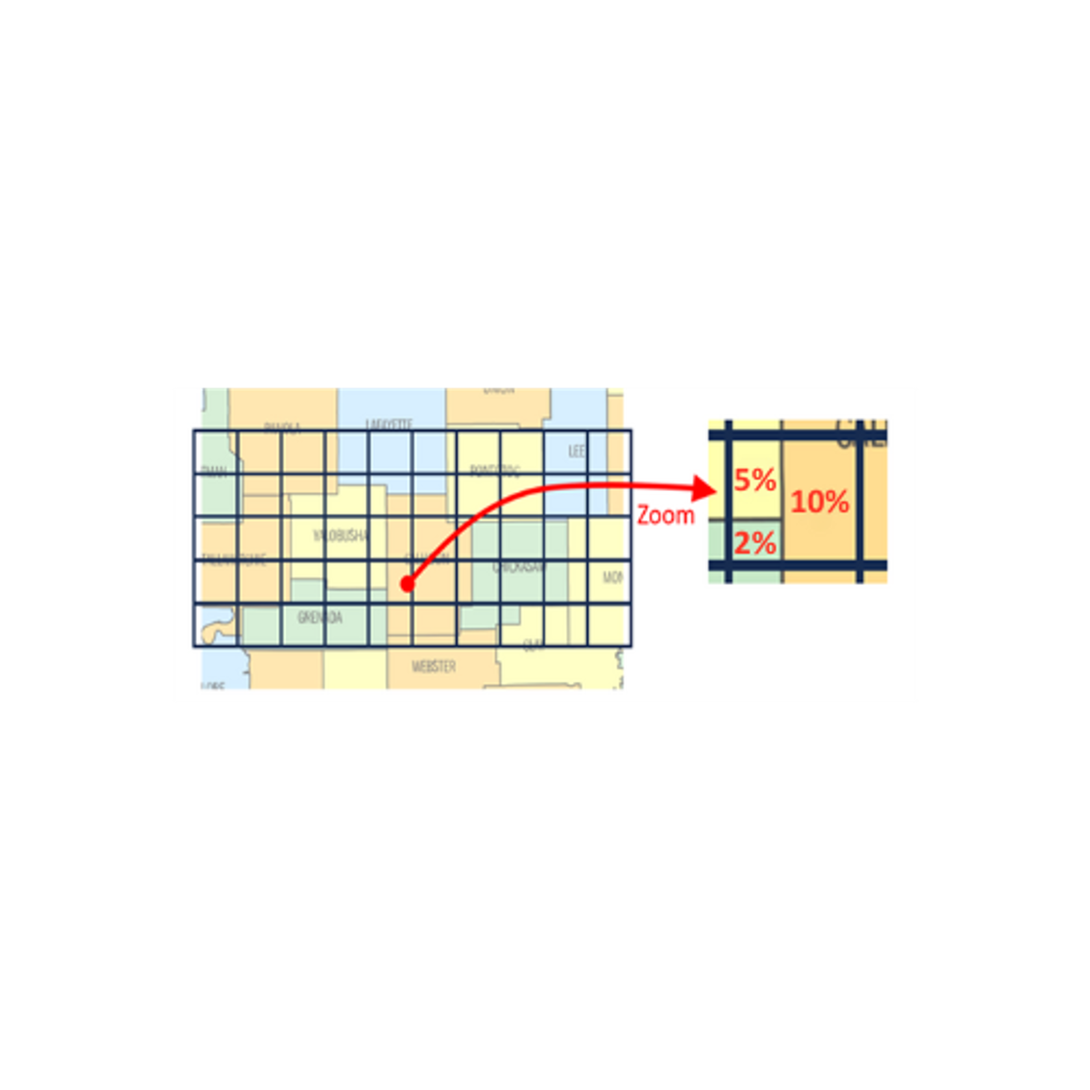
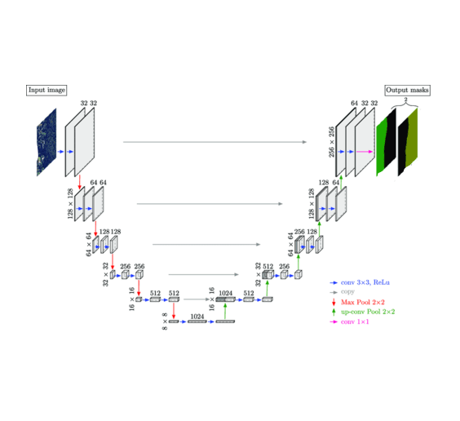
Artificial Intelligence Approach
UNET Model
Input: Aerial Proportioned Raster with Regular Grid Cells
Notes:
-unet arch uses cnn
-inputs
-proportion: percentage of county inside the grid cell
-other proportion techniques

Slide 9
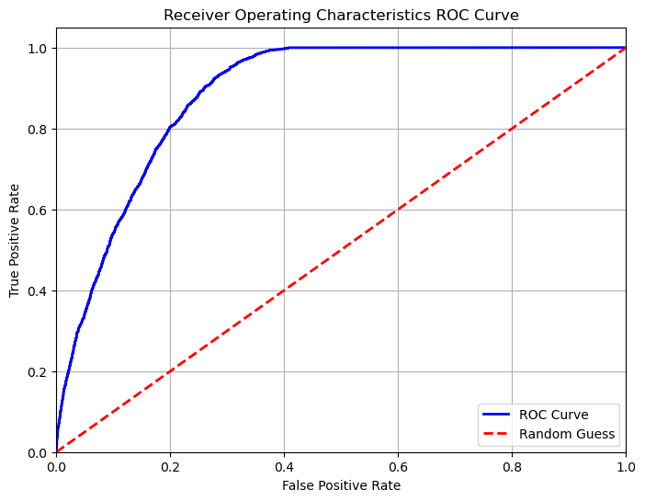
UNET Model Results
Metric | Results | Description
Accuracy | 82% | Overall performance
Precision | 74% | Measures the accuracy of positive predictions
Sensitivity | 49% | Measures the completeness of positive predictions
Area Under the Curve (AUC) | 88% | Evaluates model’s discriminatory ability comprehensively
Notes:
ROC Curve: graphical representation of overall ability to discriminate between two classes
Accuracy is overall performance of the model on testing data
When the model predicts disease instance, it is correct 74% of the time.
However, it only captures 49% of all positive incidence.
Meaning that it needs further refinement to minimize the risk of undetected disease.

Slide 10




Challenges And Solution
CHALLENGES
Solutions
Data Granularity
Artificial Intelligence Model Selection
Subsets of data may only be obtained at coarse spatial or temporal granularity, hindering detailed analysis.
Certain artificial intelligence models are better suited for data at different levels of granularity. An ensemble model approach could be adapted to the study.
Data Availability
Data Augmentation/Streamline Disease Reporting
Limited amounts of data available.
This two-pronged approach can enrich our dataset while minimizing resource-intensive efforts.
Computational Expenses
Parallelization
As models harness increasing volumes of data, there is an inevitable uptick in computational costs.
Utilizing high performance computing (SciNet Atlas Cluster) alleviates computational strain by concurrently distributing tasks across multiple processors.
Notes:
GNN
Data augmentation GAN- generate synthetic data -> discriminator network that aims to distinguish between real and fake data
Increase the volume and quality of data.

Slide 11
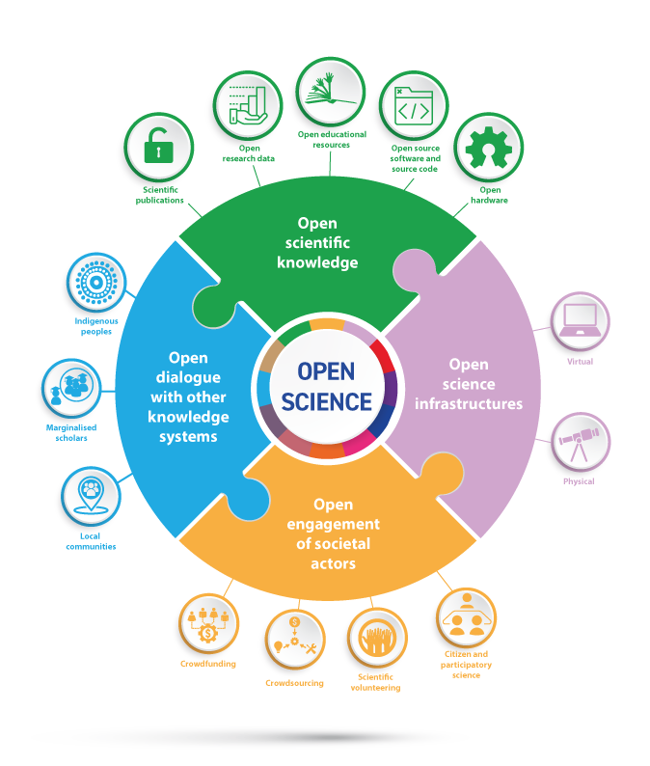
Next Steps:
Improve Model Performance
Make results accessible to stakeholders
Create automated modeling pipelines
Develop risk assessment tools that aid in:
anticipating where outbreaks may occur
prioritize surveillance/ response
mitigate/reduce the impact of disease
Notes:
-Model next steps:
Utilize temporal data
-GLSTM
-Aggressive hyperparameter tuning
-Incorporation of more data(gene)
-GAN
-Expansion to CONUS
-Transformer

Slide 12



Contributors:
Amber Mooney
USDA-ARS Foreign Animal Disease Research Postdoctoral Fellow
amber.mooney@usda.gov
Chad Fautt
USDA-ARS Foreign Animal Disease Research Postdoctoral Fellow chad.fautt@usda.gov
Brian Stucky USDA-ARS Animal Production and Protection Acting Chief Scientific Information Officer-Computational Biologist brian.stucky@usda.gov
Amy Hudson
USDA-ARS Arthropod Borne Animal Disease Research Research Ecologist amy.hudson@usda.gov
John Humphreys USDA-ARS Foreign Animal Disease Research Research Epidemiologist john.humphreys@usda.gov
Lee Cohnstaedt USDA-ARS Foreign Arthropod Borne Animal Disease Research Research Entomologist lee.cohnstaedt@usda.gov
Melanie Boudreau
Mississippi State University Assistant Research Professor - Geospatial and Conservation Science
Department of Wildlife, Aquaculture, and Fisheries
mel.r.boudreau@gmail.com

